Slide 1
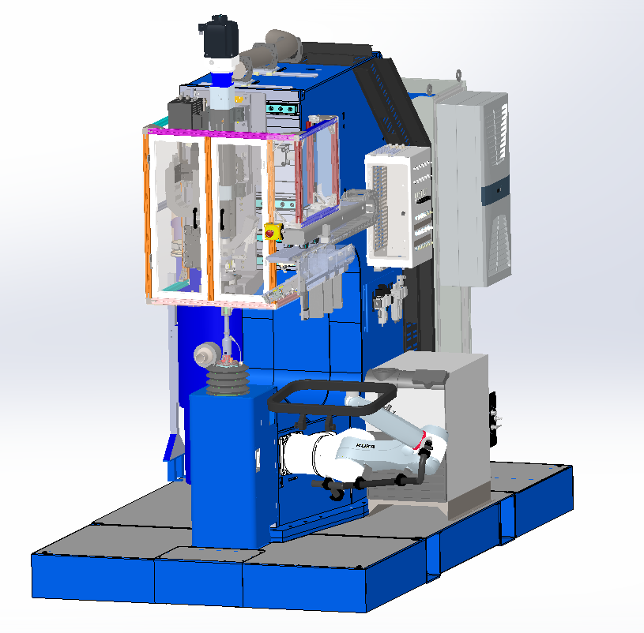
Automated access hatch
riveting concept
FLEX RIVETER
ROBOT ARM
INTERCHANGEABLE TOOLING FRAME

Slide 2
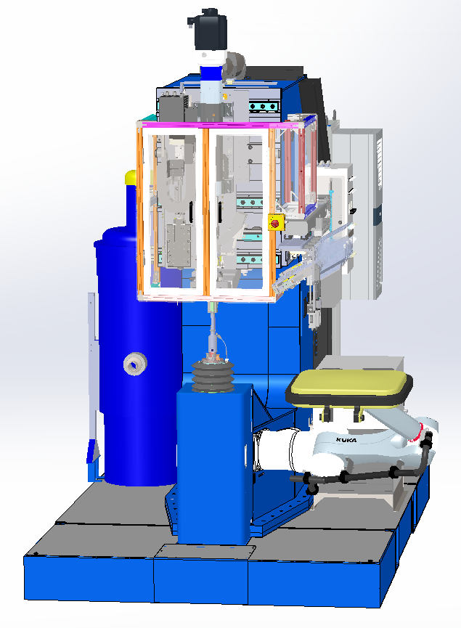
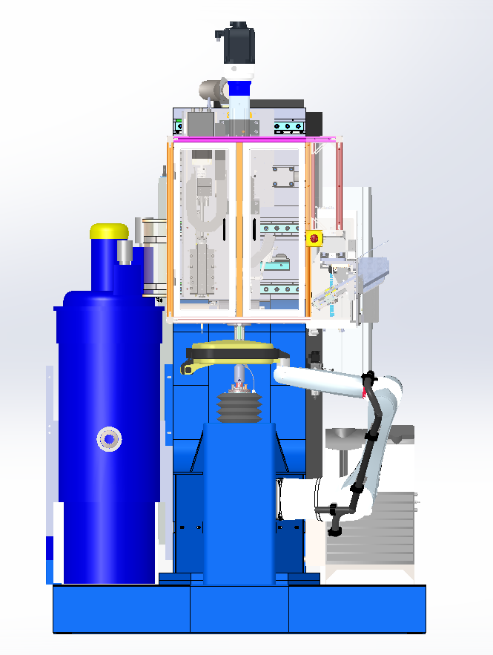
LOADING POSITION
HATCH LOADED IN FRAME
HATCH IN WORK

Slide 3
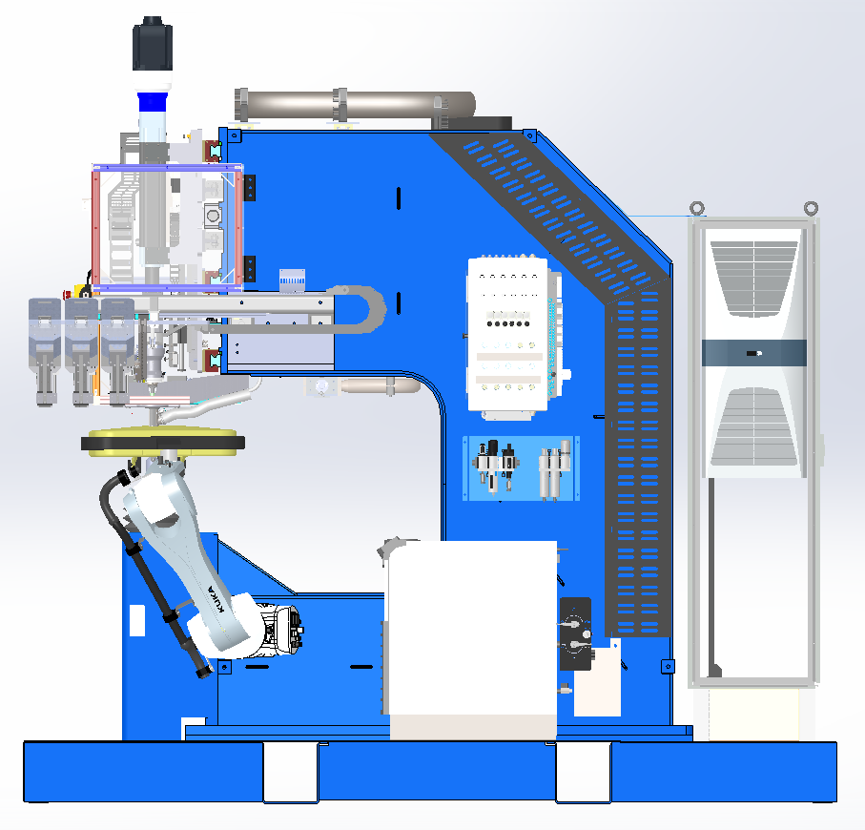
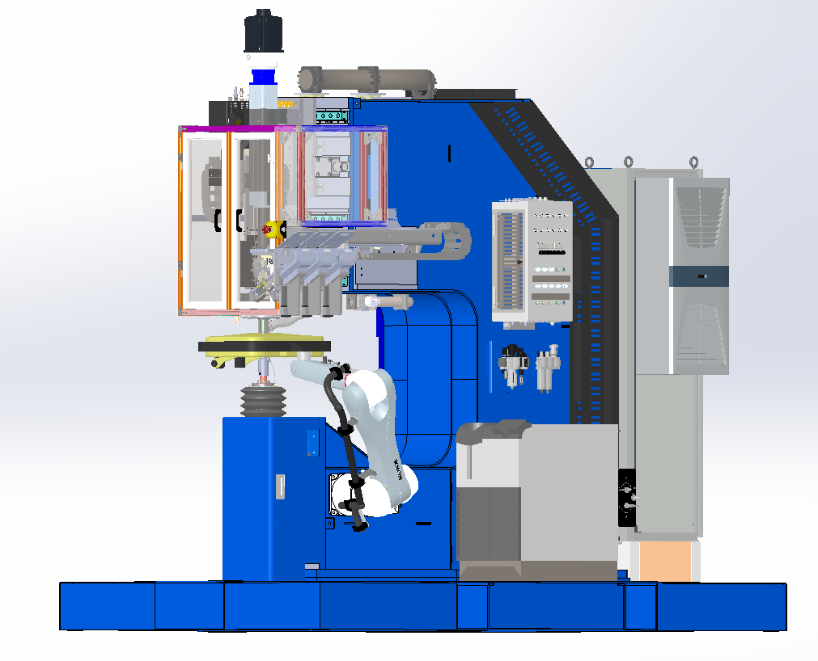
ROBOT ARM MANIPULATES PART FOR FULLY AUTOMATED RIVETING PROCESS
INTERCHANGEABLE TOOLING AND PART PROGRAMS OFFER FLEXIBILITY TO AUTOMATE RIVETING OF MANY PARTS WITH ONE SETUP

